Slide 1
In Text Citations in APA
Watch a brief tutorial and then play a game!

Slide 2
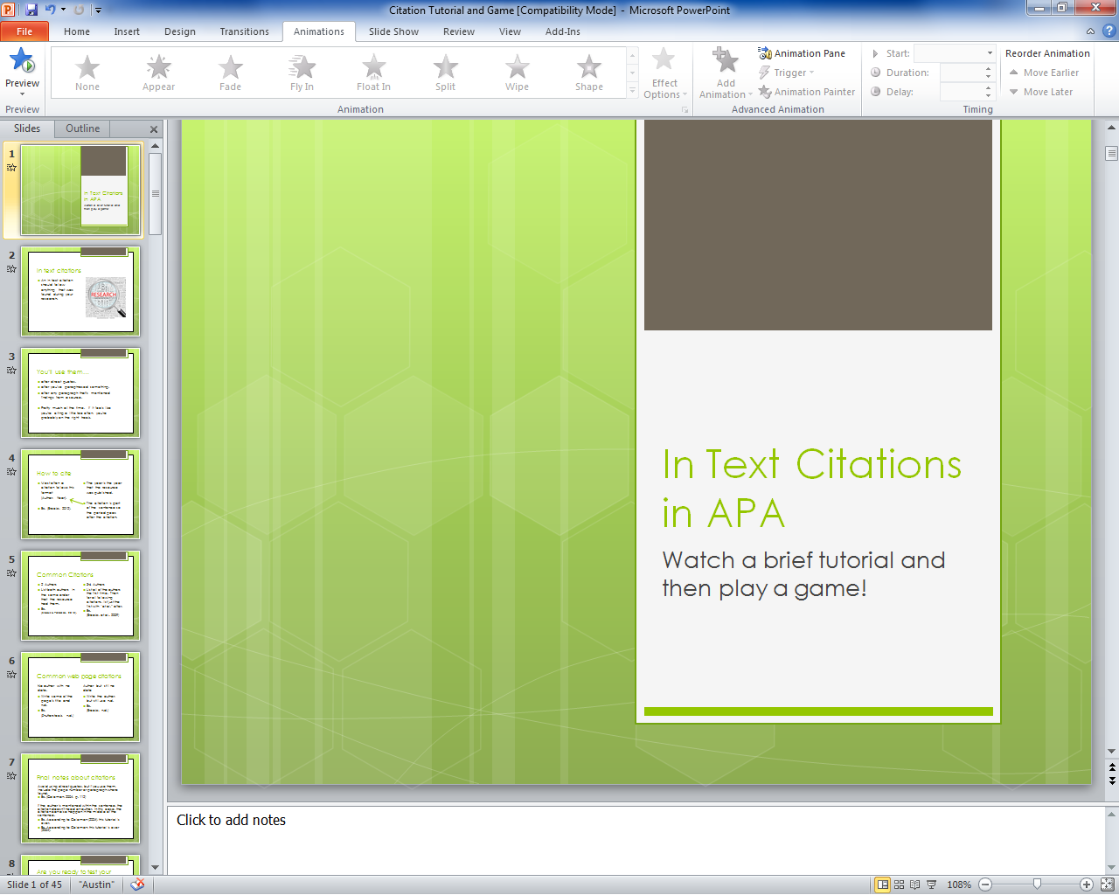
If you haven’t done so already, please view this PowerPoint in Slide Show view.
Click F5 to start the show.
Or click this icon at the bottom of your screen.

Slide 3

In text citations
An in text citation should follow anything that was found during your research.

Slide 4
You’ll use them…
after direct quotes.
after you’ve paraphrased something.
after any paragraph that’s mentioned findings from a source.
Pretty much all the time. If it feels like you’re citing a little too often, you’re probably on the right track.

Slide 5
How to cite
Most often a citation follows this format
(Author, Year).
Ex. (Brooks, 2012).
The year is the year that the resource was published.
The citation is part of the sentence so the period goes after the citation.

Slide 6
Common Citations
2 Authors
List both authors in the same order that the resource had them.
Ex.
(Brooks & Paradise, 2010).
3-6 Authors
List all of the authors the first time. Then for all following citations, list just the first with “et al.” after.
Ex.
(Brooks et al., 2009)

Slide 7
Common web page citations
No author with no date.
Write some of the page’s title and n.d.
Ex.
(Shutterstock, n.d.)
Author but still no date
Write the author, but still use n.d.
Ex.
(Brooks, n.d.)

Slide 8
Final notes about citations
Avoid using direct quotes, but if you use them, include the page number or paragraph where found.
Ex. (Coleman, 2004, p. 112)
If the author is mentioned within the sentence, the citation doesn’t need an author. In this case, the citation can also happen in the middle of the sentence.
Ex. According to Coleman (2004), this tutorial is over.
Ex. According to Coleman, this tutorial is over (2004).

Slide 9
Are you ready to test your knowledge?
I hope you’ve taken good notes.
A quiz/game is going to follow this slide.
Once the game has started, click “100” to start the first question.
Good luck!

Slide 10

Who Wants to Cite a Millionaire?
Created by Terri Street
Copyright, 2000
Notes:
Lifeline icons on the question slides are hyperlinks which will take you to the lifeline screen. To return to the game, you may right click on the screen, choose Go, Previously Viewed. This should return you to the question slide. Alternatively, left click as usual to return to the game board, then click on the highest number that has been previously selected (in gold to indicate a followed hyperlink).
To utilize the 50:50 option, the moderator may tell the contestant which two options to disregard or, use Control-P to change the mouse arrow to a pen. Draw a line through two incorrect responses, then use Control-A to change the pen back into an arrow and continue with the game.
Clicking on the action button on the phone handset image of the Phone a Friend lifeline slide will hyperlink to the Ask Jeeves web site where the participant may ask for help.

Slide 11
1,000,000
500,000
250,000
125,000
64,000
32,000
16,000
8,000
4,000
2,000
1,000
500
300
200
100
Who Wants to Cite a Millionaire?
Select a dollar amount to play.

Slide 12
A citation is used to show what was found through…
A. Research
B. Asking a friend
C. Observation
D. Making things up

Slide 13
A. Research
Click here to select the next dollar amount.
Back to Board

Slide 14
A citation contains the year of publication and the…
A. publisher
B. journal
C. author’s last name
D. author’s first name

Slide 15
C. author’s last name
Back to Board

Slide 16
The sentence period goes ___ the citation.
A. before and after
B. after
C. before
D. inside

Slide 17
B. after
Back to Board

Slide 18
With 2 authors, you should cite…
A. both of them
B. the article title
C. the first one listed
D. the first with et al.

Slide 19

A. both of them
Back to Board

Slide 20
Does the citation include the author’s initials?
B. Only if there is
one author
A. Only if listed
C. Yes
D. No

Slide 21
D. No
Back to Board

Slide 22
What’s wrong with this citation: (Ender, 1997).
A. Missing initials
B. No page number
C. Nothing
D. Period is after

Slide 23
C. Nothing
Back to Board

Slide 24
A direct quote should include…
A. a word count
B. a page number
C. the title
D. the author’s initials

Slide 25
B. a page number
Back to Board

Slide 26
What citation matches this reference:
Chris, D. (n.d). Education: PowerPoint presentations. Current Anesthesia & Critical Care, 15, 69-73.
A. (D, 2013).
B. (Chris, D., n.d).
C. (Chris, n.d).
D. (D. Chris, 2013).

Slide 27
C. (Chris, n.d).
Back to Board

Slide 28
When first citing this reference, what citation would be used?
Tous, R., Guerrero, M., &Delgado, J. (2011). Semantic web for reliable
citation analysis in scholarly publishing. Information
Technology & Libraries, 30(1), 24-33.
A. (Tous et al., 2011).
B. (Delgado et al., 2011).
C. (Delgado, Guerrero, Tous, 2011).
D. (Tous, Guerrero, & Delgado, 2011).

Slide 29
D. (Tous, Guerrero, Delgado, 2011).
Back to Board

Slide 30
How often should you use citations?
B. After every statement
of info found in research
A. Often
C. Once per paragraph
D. After every sentence

Slide 31
B. After every statement
of info found in research
Back to Board

Slide 32
What should a citation look like if there is no year listed?
A. (Brooks, n.d.)
B. (Brooks, 2013)
C. (Brooks, no date)
D. (Brooks n.d.)

Slide 33
A. (Brooks, n.d.)
Back to Board

Slide 34
Cite this quote correctly:
“deep learning on multimedia slide design”
A. (Ronald, p. 162, 2011)
B. (Ronald, 2011, p. 162)
C. (Ronald, p. 162)
D. (Ronald, 2011, 162)

Slide 35
B. (Ronald, 2011, p. 162)
Back to Board

Slide 36
When citing this for a second time, what citation should be used?
Tous, R., Guerrero, M., &Delgado, J. (2011). Semantic web for reliable
citation analysis in scholarly publishing. Information
Technology & Libraries, 30(1), 24-33.
A.(Tous, Guerrero, Delgado, 2011).
B. (Delgado et al., 2011).
C. (Tous et al., 2011).
D. (Tous R. et al., 2011).

Slide 37
C. (Tous et al., 2011).
Back to Board

Slide 38
Is this citation correct: Basu and Jones (2007) went so far as to suggest the need for a new framework.
A. The names should
be in parenthesis.
B. The year has to
go at the end.
C. The last names are
missing.
D. Yes it’s correct

Slide 39
D. Yes it’s correct.
Back to Board

Slide 40
What should you do if you still have questions about citations?
B. Contact your
instructor
A. All of these
C. Use the style
guide
D. Search online

Slide 41
A. Congratulations!

Slide 42
Sorry, try again!

Slide 43
Thanks for playing!

